Slide 1




Roundtable introduction
WELCOME!
@EcoCommonsAus
Species Distribution Modelling in R
Step 2: Environmental data
Dr Rob Clemens (he/him)
Change & Communications E: comms@ecocommons.org.au
T: @EcoCommonsAus
@RobertSClemens1
Notes:
Welcome to the workshop: Using the BCCVL to solve environmental problems, brought to you by the EcoCommons program
Firstly, as we gather for this workshop dispersed across many physical locations, I would like to take a moment to acknowledge the various traditional owners of the lands on which we meet, including the the Traditional Custodians of the ACT, the Ngunnawal people where I am today. I acknowledge the Elders – past, present and emerging of all the lands that we work and live on, and recognise their extraordinary contributions to the cultural, economic and scientific domains that we will discuss today.

Slide 2
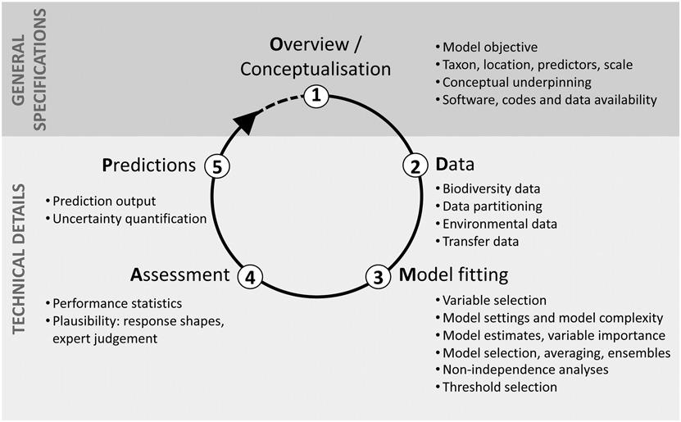
Overview of the process
Zurell, et. al.(2020), A standard protocol for reporting species distribution models. Ecography, 43: 1261-1277. https://doi.org/10.1111/ecog.04960

Slide 3
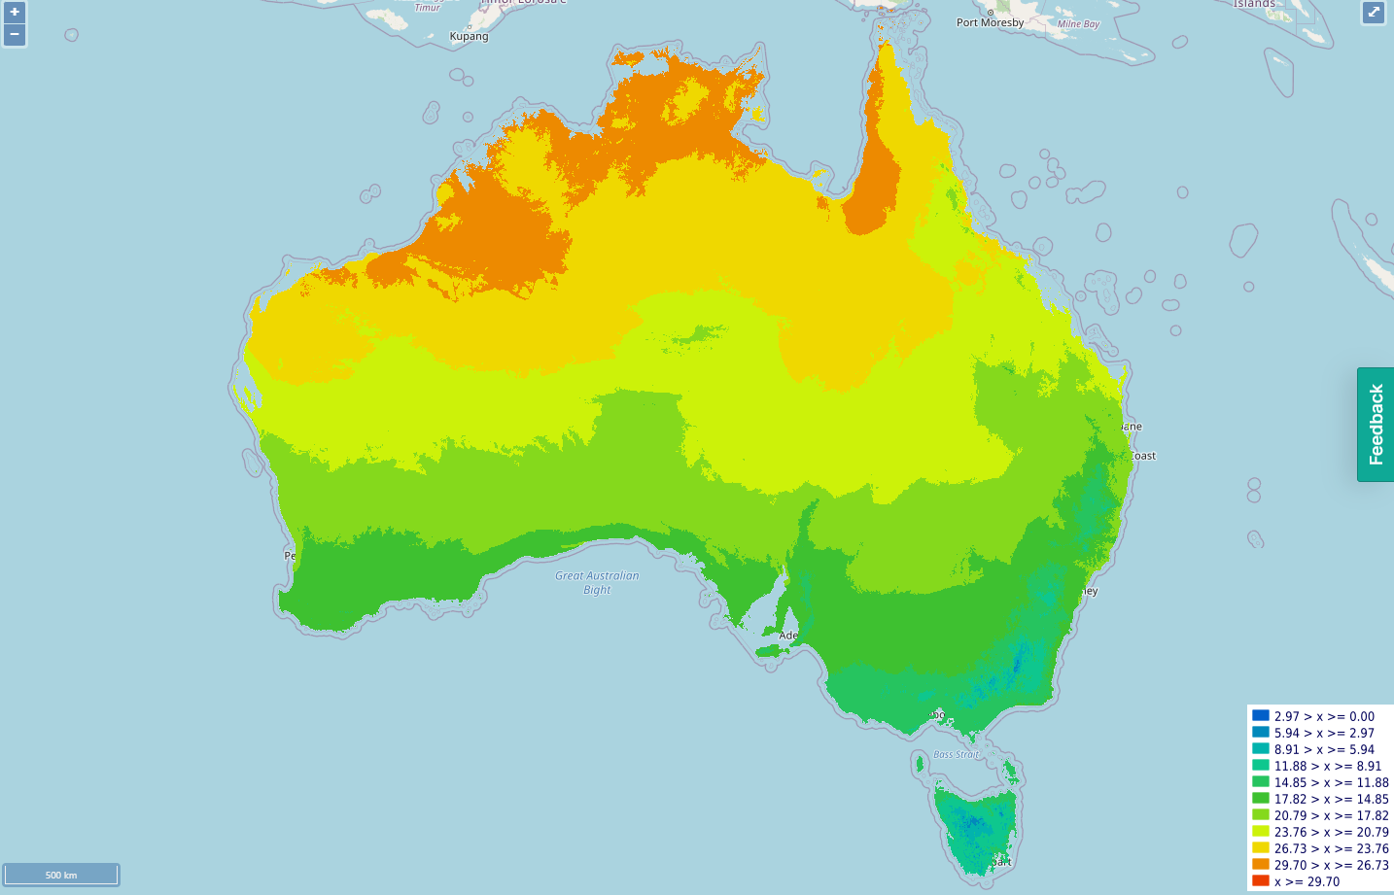
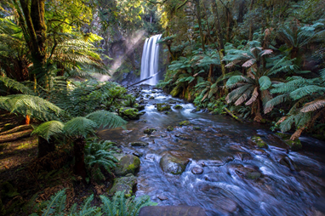
Spatial autocorrelation #1 reason your AUC might be too high
Predictions may be less accurate than they appear if there is spatial autocorrelation in the residuals
Average temperature
Notes:
However, if you look up a distribution map of a species, it often shows a range rather than dots on a map. So, how do we go from specific places where individuals of a species have been observed to producing a map that gives an estimate of the distribution of that species? This is where species distribution models come into play.

Slide 4
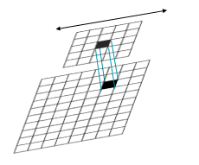
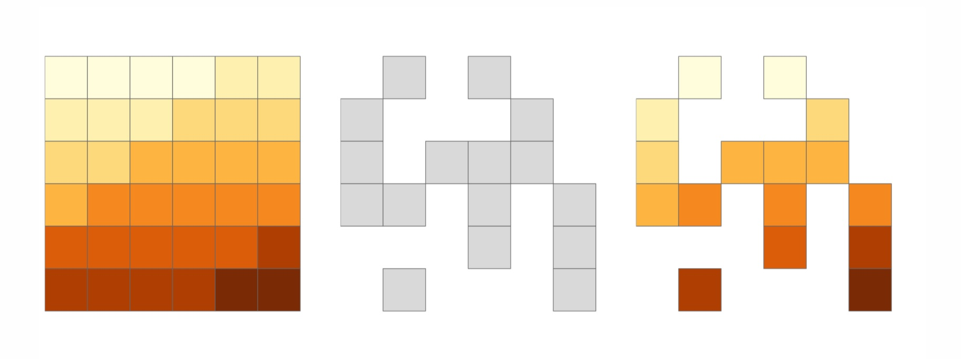
Does available data match your question?
Temporal agreement between occurrence records and environmental predictors
Extent
Larger often better
Masking out areas where the species does not occur can be more interesting.
Resolution
What grid size makes sense?
Smaller grid cells often better
Use neighborhood functions to capture larger scale variation in small grid cells
https://geocompr.robinlovelace.net/spatial-operations.html

Slide 5
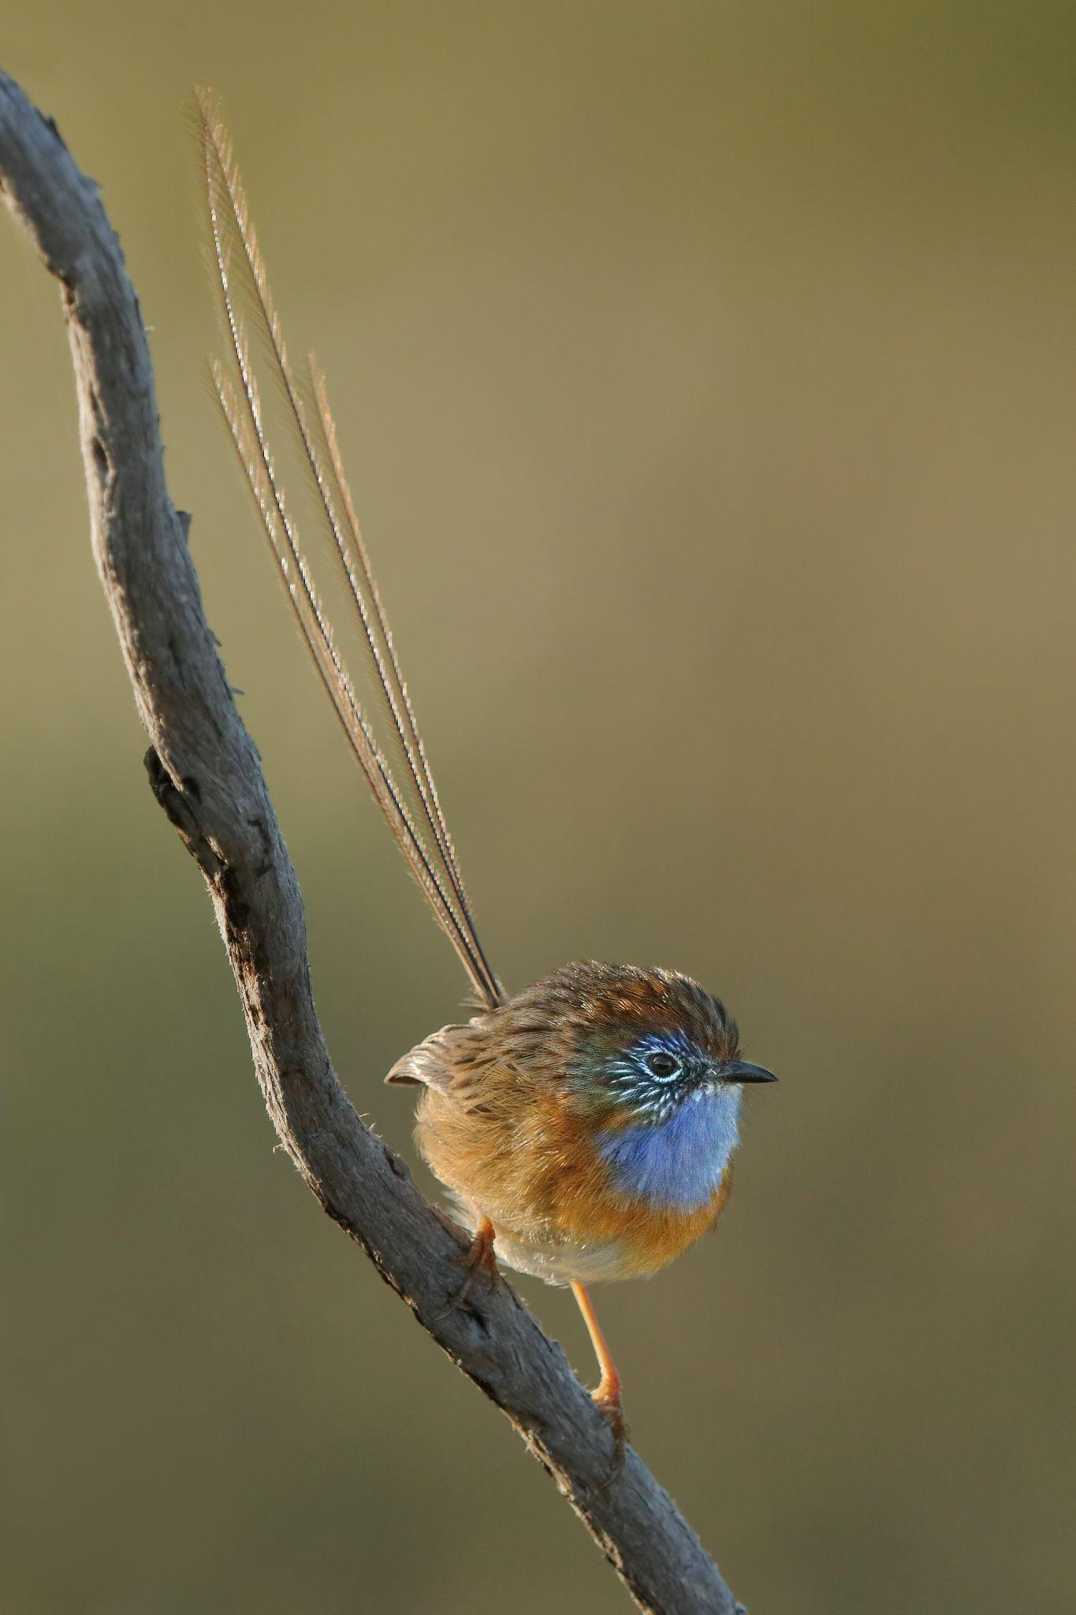
Environmental data
Ecologically related to your species
Vegetation
Greenness
Structure
Type
Water
Distance to
Area of open water
Land use
Land cover
Elevation
Slope / aspect
Photo: Ian Wilson
Notes:
The most common types of environmental variables that are used in species distribution modelling are described by four classes of physical conditions, called the primary environmental regimes: moisture, thermal, radiation, and mineral nutrients.
(C) The moisture regime is mostly described by measures of rainfall and evaporation,
(C) the thermal regime by temperature measures.
(C) The radiation regime refers to solar radiation or sunlight, which is usually measured by the photosynthetically active radiation, or PAR. This is the spectral range of solar radiation that photosynthesising organisms, such as plants and algae, are able to use in the process of photosynthesis. This spectral region corresponds more or less with the range of light that is visible to the human eye.
(C) The mineral nutrients regime is determined by the soil type.
Of course In the real world, there are a wide variety of variables which can influence the distribution of a particular species such as competition, land use history and disturbance regimes, but the algorithms we’re using today only focus on the more fundamental primary environmental regimes.

Slide 6
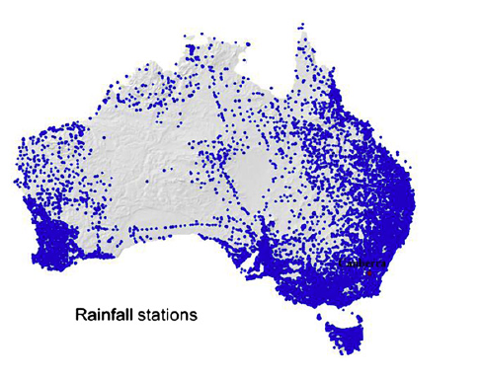
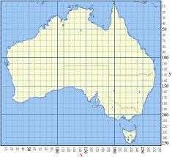
Environmental data
How is environmental data generated?
Recording stations
Min
Source: Xu, T., & Hutchinson, M. F. (2013). New developments and applications in the ANUCLIM spatial climatic and bioclimatic modelling package. Environmental Modelling & Software, 40, 267-279.
Notes:
Therefore, the raw data are processed to generate summary statistics such as the mean annual temperature, or the minimum or maximum of the warmest/coldest, wettest/driest month or season.
Such minimum or maximum values make much more sense in species distribution modelling as the probability of a species occurring in a particular place is often influenced by a threshold of an environmental factor.
For example, if a species cannot tolerate temperatures above or below a certain threshold, variables that represent minimum or maximum values are very useful to describe the environmental conditions under which a species is able to survive.

Slide 7

Environmental data
How is environmental data generated?
Recording stations
Summary statistics
Spatial interpolation
Temperature (°C) at stations
Temperature (°C) interpolated
20
13 | 14 | 16 | 20 | 23
14 | 14 | 16 | 19 | 24
18 | 16 | 16 | 18 | 22
24 | 22 | 19 | 19 | 21
30 | 27 | 23 | 20 | 20
14
24
Mean
Max
Min
16
30
27
20
Source: Adapted from http://planet.botany.uwc.ac.za/nisl/GIS/spatial/chap_1_11.h
Notes:
So the summary statistics are generated from daily measurements at particular locations.
To use this point data in a model, it needs to be converted to a grid, in which each cell has a value for a particular environmental variable, including the cells for which no measurements exist.
Because the point data doesn’t give us a value for each cell, (C) we use a technique called spatial interpolation that predicts values for unknown cells from a limited number of sample data points around that cell.
This interpolation is based on the assumption that cells that are close together tend to have similar characteristics. The resulting grid is what is known as a ‘raster surface’.

Slide 8
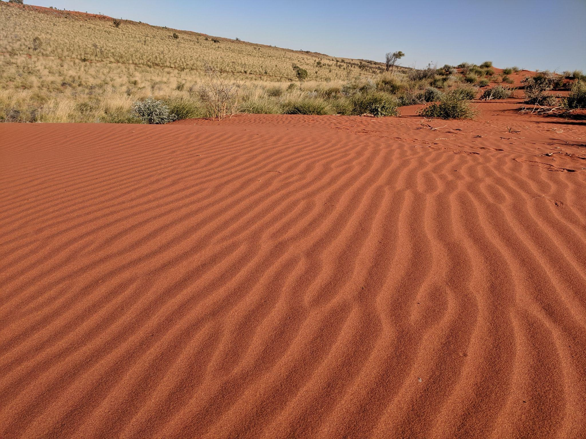
Step 2: Environmental data
Match, extent, resolution and coordinate reference system
Focal function to run neighborhood functions
Stack our environmental variables
Notes:
However, if you look up a distribution map of a species, it often shows a range rather than dots on a map. So, how do we go from specific places where individuals of a species have been observed to producing a map that gives an estimate of the distribution of that species? This is where species distribution models come into play.

Slide 9
Step 2: Environmental data
# Provide users with AWAP grid, wetland grid
AWAP1<-raster("raw_data/awap_WRel1End.tif")
AWAP2 <-projectRaster(AWAP1,base)
AWAP3<- mask(AWAP2,base)
AWAP <- AWAP3
base <- raster("data/base_LiPe.asc")
crs(base) <- "+proj=longlat +datum=WGS84 +no_defs"
# looked at NVIS data, not useful for this model
NVIS1<-raster("raw_data/nvis-2020-90m_aus6_0e_mvg_amvg.tif")
Notes:
However, if you look up a distribution map of a species, it often shows a range rather than dots on a map. So, how do we go from specific places where individuals of a species have been observed to producing a map that gives an estimate of the distribution of that species? This is where species distribution models come into play.

Slide 10
Step 2: Environmental data (cont)
wetland1 <- raster('wet_cov.asc')
crs(wetland1) <- "+proj=longlat +datum=WGS84 +no_defs"
wetland2 <-projectRaster(wetland1,base)
wetland3<- mask(wetland2,base)
wetland_connectivity <- focal(wetland3, w=matrix(1, nrow = 11, ncol = 11),fun=sum,na.rm=TRUE)
EVI1<- raster("https://api.data-ingester.app.ecocommons.org.au/api/data/34ab5ea6-650f-503f-9446-88d0ae9effe1/download/ndlc-2004-250m_trend-evi-mean.tif")
EVI2 <-projectRaster(EVI1,base)
EVI3<- mask(EVI2,base)
EVI <- EVI3
Notes:
However, if you look up a distribution map of a species, it often shows a range rather than dots on a map. So, how do we go from specific places where individuals of a species have been observed to producing a map that gives an estimate of the distribution of that species? This is where species distribution models come into play.

Slide 11
Step 2: Environmental data (cont)
wetland1 <- raster('wet_cov.asc')
crs(wetland1) <- "+proj=longlat +datum=WGS84 +no_defs"
wetland2 <-projectRaster(wetland1,base)
wetland3<- mask(wetland2,base)
Bioclim05_1 <- raster("https://api.data-ingester.app.ecocommons.org.au/api/data/cc081daa-f524-58c2-939e-166a2b2e79eb/download/current_1976-2005_bioclim-05.tif")
Bioclim05_2 <-projectRaster(Bioclim05_1,base)
Bioclim05_3 <- mask(Bioclim05_2 ,base)
Bioclim05 <- Bioclim05_3
writeRaster(Bioclim05,"predictors/Bioclim05.asc")
# repeat for Bioclim 6, Bioclim12,
Notes:
However, if you look up a distribution map of a species, it often shows a range rather than dots on a map. So, how do we go from specific places where individuals of a species have been observed to producing a map that gives an estimate of the distribution of that species? This is where species distribution models come into play.

Slide 12
Step 2: Environmental data (cont)
wetland1 <- raster('wet_cov.asc')
crs(wetland1) <- "+proj=longlat +datum=WGS84 +no_defs"
wetland2 <-projectRaster(wetland1,base)
wetland3<- mask(wetland2,base)
Bioclim05_1 <- raster("https://api.data-ingester.app.ecocommons.org.au/api/data/cc081daa-f524-58c2-939e-166a2b2e79eb/download/current_1976-2005_bioclim-05.tif")
Bioclim05_2 <-projectRaster(Bioclim05_1,base)
Bioclim05_3 <- mask(Bioclim05_2 ,base)
Bioclim05 <- Bioclim05_3
writeRaster(Bioclim05,"predictors/Bioclim05.asc")
# repeat for Bioclim 6, Bioclim12,
Notes:
However, if you look up a distribution map of a species, it often shows a range rather than dots on a map. So, how do we go from specific places where individuals of a species have been observed to producing a map that gives an estimate of the distribution of that species? This is where species distribution models come into play.

Slide 13
Step 2: Environmental data (cont)
preds_current <- stack(AWAP,wetland_connectivity,EVI,Bioclim05,Bioclim06,Bioclim12)
preds_current2 <- setNames(preds_current,c("AWAP","wetland_connectivity","EVI","Bioclim05","Bioclim06","Bioclim12"))
# Repeat again with future climate data
Bioclim05_1 <- raster("https://api.data-ingester.app.ecocommons.org.au/api/data/34fe63e3-4152-5406-96f7-dd67f54be5f5/download/SRESA1
writeRaster(Bioclim05,"predictors_future/Bioclim05.asc")
Notes:
However, if you look up a distribution map of a species, it often shows a range rather than dots on a map. So, how do we go from specific places where individuals of a species have been observed to producing a map that gives an estimate of the distribution of that species? This is where species distribution models come into play.

Slide 14
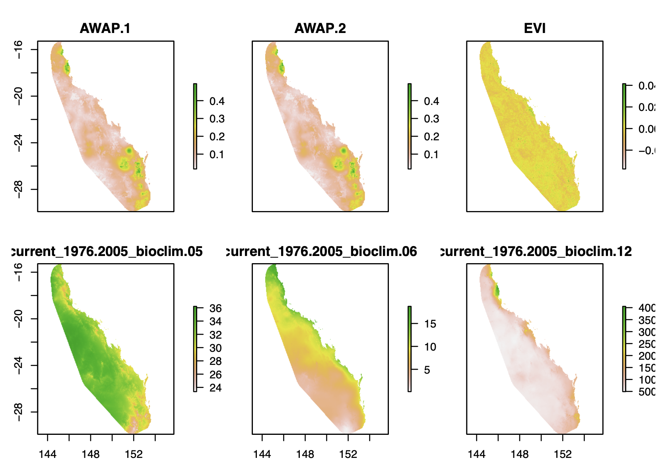
Step 2: Environmental data (cont)
Notes:
However, if you look up a distribution map of a species, it often shows a range rather than dots on a map. So, how do we go from specific places where individuals of a species have been observed to producing a map that gives an estimate of the distribution of that species? This is where species distribution models come into play.

Slide 15

We would welcome your feedback
Press feedback button to tell us what changes you want & to highlight anything that is not working.
The site may slow down or go down as our software developers work on it. Public release Nov 2022
To learn basics of R coding
https://datacarpentry.org/R-ecology-lesson/
https://www.ecocommons.org.au/
Notes:
You can find out more about EcoCommons on our webpage: ecocommons.org.au.
To raise awareness of the current extinction crisis, we launched our webpage on Threatened Species Day which remembers the extinction of the Tasmanian tiger (Thylacinus cynocephalus) in 1936. EcoCommons is committed to help researchers and policy-decision makers stop further extinctions by empowering them with data and analytics to do better informed management of Australia’s 1900+ threatened species.
On our webpage you can find out:
How you can become an EcoCommons Pioneer and be the first to explore and test new tools!
Follow our journey - sign up for our newsletter
Follow us on twitter or LinkedIn: @EcoCommonsAus
Collaborate with us!

Slide 16
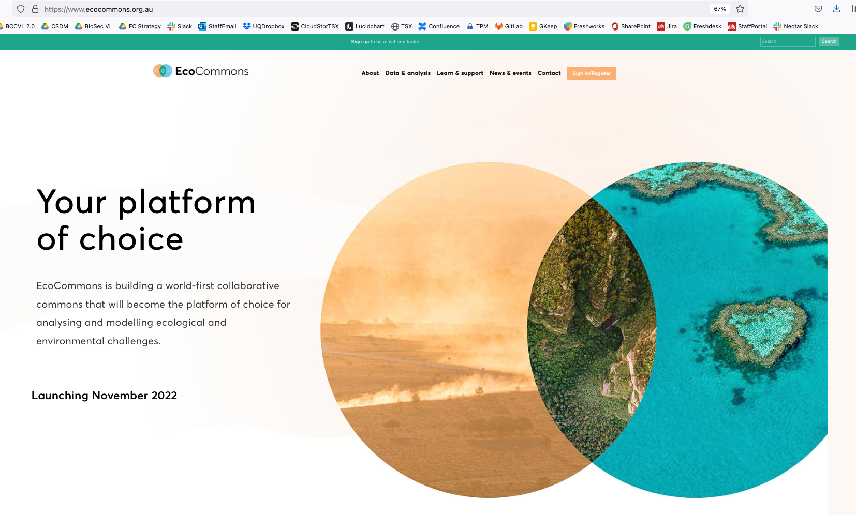
Explore EcoCommons webpage
Follow our Journey
https://www.ecocommons.org.au/
Notes:
You can find out more about EcoCommons on our webpage: ecocommons.org.au.
To raise awareness of the current extinction crisis, we launched our webpage on Threatened Species Day which remembers the extinction of the Tasmanian tiger (Thylacinus cynocephalus) in 1936. EcoCommons is committed to help researchers and policy-decision makers stop further extinctions by empowering them with data and analytics to do better informed management of Australia’s 1900+ threatened species.
On our webpage you can find out:
How you can become an EcoCommons Pioneer and be the first to explore and test new tools!
Follow our journey - sign up for our newsletter
Follow us on twitter or LinkedIn: @EcoCommonsAus
Collaborate with us!

Slide 17


We gratefully acknowledge:

Slide 18


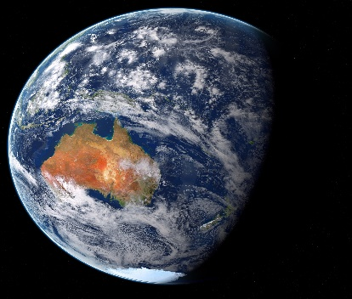
Thank You

